Slide 1

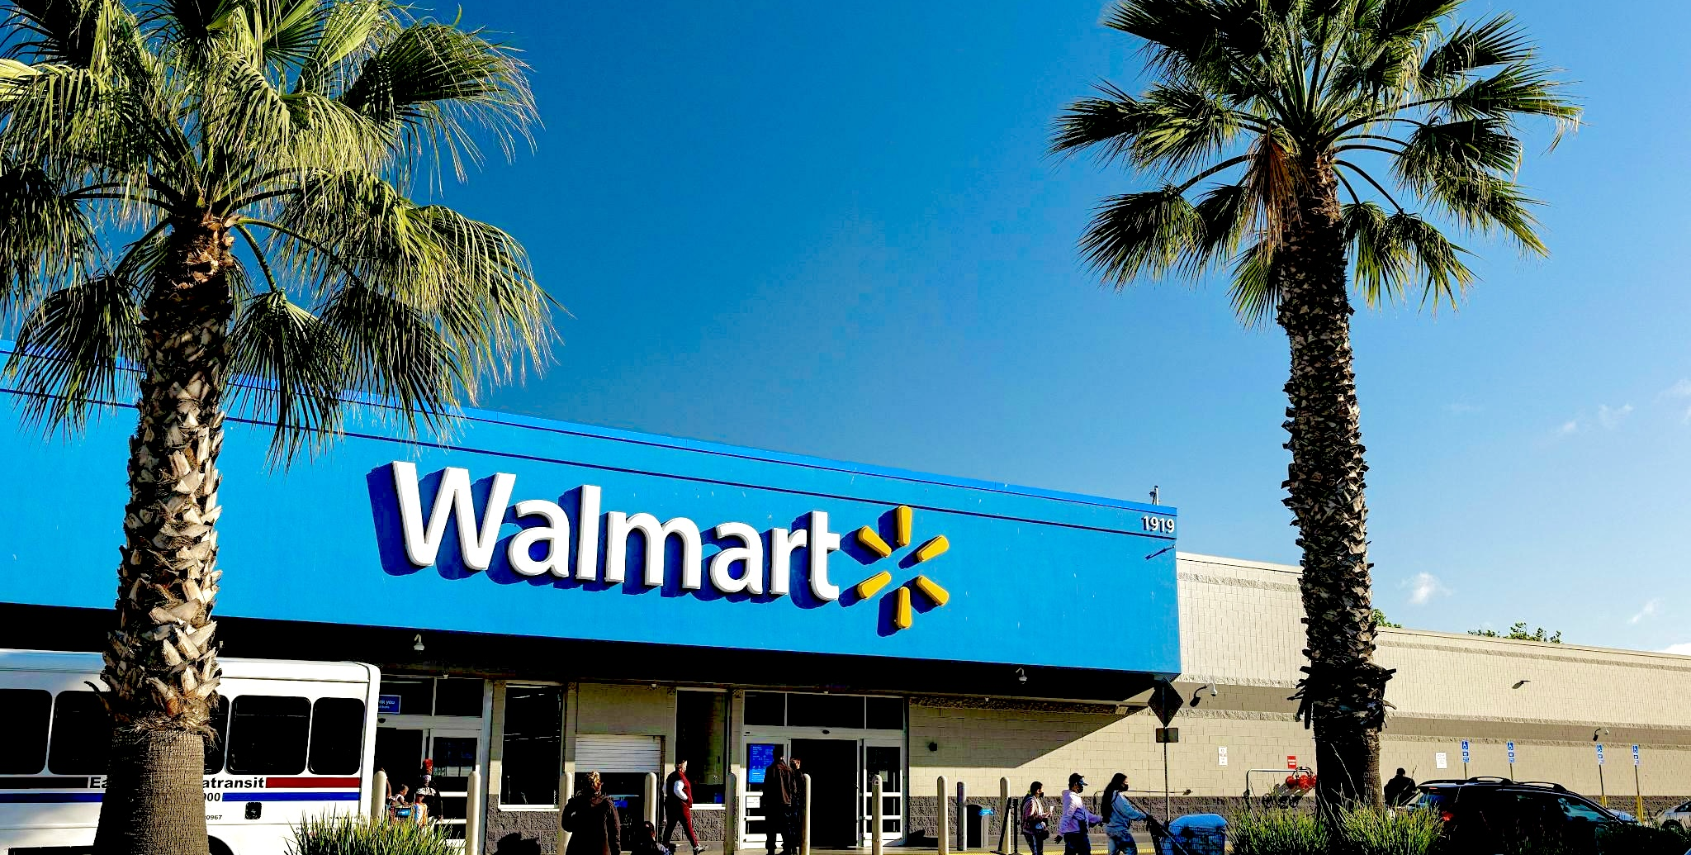
Sales Forecast
A presentation by:-
Submitted to :-
Abhinav Mahajan (2210990037)
Aditya Chhabra (2210990063)
Aditya Vashisht (2210990074)
Advitya Hans (2210990076)
Mr. Sankalp Agnihotri

Slide 2

Index
Introduction
Problem Statement
Libraries used
Advantages
Forecasting methodologies
Future Trends of Sales Forecasting
Snapshots of Graphs used
Conclusion

Slide 3
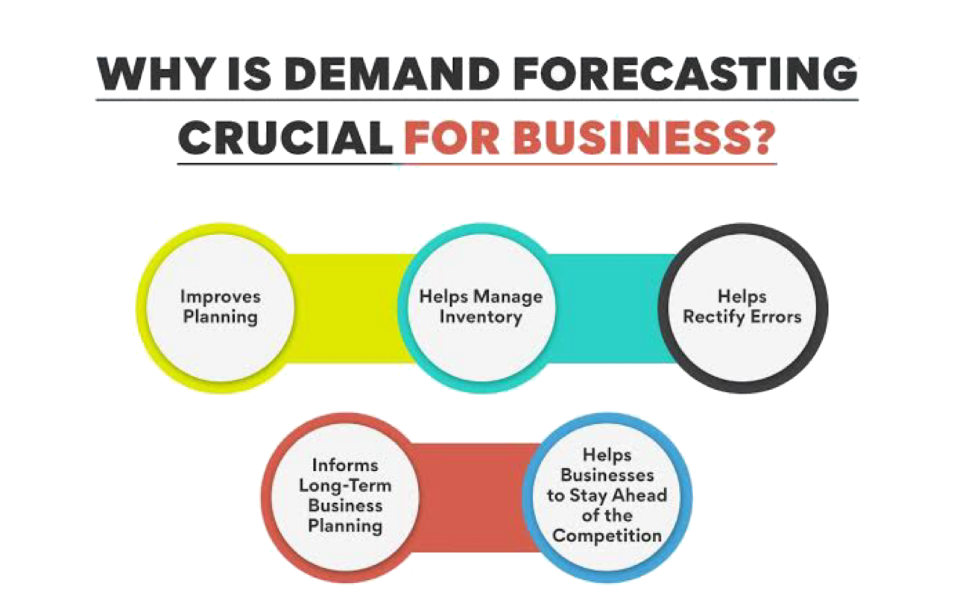
Introduction
Sales forecasting serves as a compass for retailers, guiding strategic decisions and operational planning. For a behemoth like Walmart, accurate forecasting isn't just advantageous; it's essential for maintaining its position as a leader in the industry.
Throughout this presentation, we'll explore the methodologies employed by Walmart, the influential factors shaping its sales trajectory, and the critical importance of forecasting accuracy. Furthermore, we'll glance into the future, anticipating emerging trends and innovations in retail sales forecasting.

Slide 4
Problem Statement
Walmart, as a leading retailer, faces the critical challenge of accurately predicting sales to optimise operations, manage inventory effectively, and meet customer demand. Despite employing advanced forecasting techniques and leveraging vast amounts of data, there remains a need to enhance the accuracy and efficiency of Walmart's sales forecasts.
Key issues include:
Forecasting Inaccuracy: Existing forecasting models may fail to capture fluctuations in consumer behavior, leading to inaccurate predictions and potential revenue loss due to stockouts or excess inventory.
Complexity of Data Analysis: Walmart deals with vast and diverse datasets, making it challenging to extract actionable insights efficiently. As a result, there may be delays in decision-making and suboptimal resource allocation.
Dynamic Market Conditions: The retail landscape is constantly evolving, influenced by factors such as economic trends, competitor strategies, and changing consumer preferences. Adapting forecasting models to these dynamic conditions requires agility and flexibility.

Slide 5

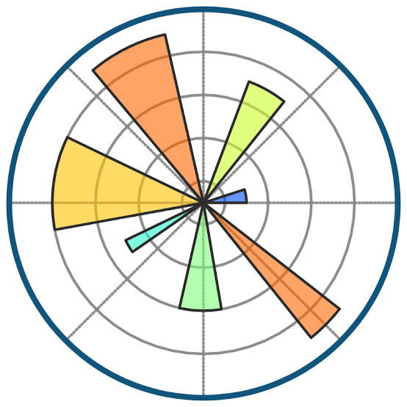


Libraries used :-
Matplotlib
NumPy
Pandas

Slide 6

Advantages of using Walmart Sales Forecast
Enhanced Inventory Management
-Accurate sales forecasts help Walmart optimise inventory levels.
-It ensures adequate stock availability to meet customer demand while minimising excess inventory costs.
Improved Resource Allocation
-By forecasting sales accurately, Walmart can allocate resources efficiently.
-This includes staff scheduling, procurement, and allocation of marketing budgets.
Strategic Planning
-Sales forecasting provides valuable insights for long-term strategic planning.
-It helps Walmart make informed decisions regarding expansion, product launches, and market penetration strategies.

Slide 7

Cost Reduction
-By anticipating sales trends, Walmart can negotiate better terms with suppliers.
-It enables cost-saving initiatives by minimising stockouts, markdowns, and overstock situations.
Enhanced Customer Satisfaction
-Accurate sales forecasts ensure product availability, reducing instances of out-of-stock items.
-This leads to improved customer satisfaction and loyalty.
Competitive Advantage
-Walmart can gain a competitive edge by leveraging accurate sales forecasts.
-It allows the company to respond promptly to market changes and stay ahead of competitors.

Slide 8
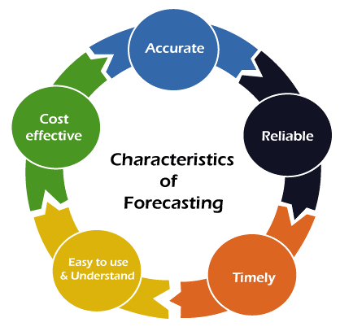
Forecast Methodologies
Forecasting Model Selection:
Explanation of the chosen forecasting model/method (e.g., Time Series Analysis, Regression Analysis, etc.)
Justification for why this model was selected (e.g., historical accuracy, suitability for retail sales forecasting).
Assumptions and Considerations:
Clear articulation of any assumptions made during the forecasting process (e.g., stable economic conditions, consistent consumer behaviour ).
Identification of any external factors or events (e.g., COVID-19 pandemic, supply chain disruptions) and how they were incorporated into the forecast.
Limitations and Risks:
Honest acknowledgment of the limitations inherent in the forecasting model/method (e.g., potential for unforeseen market changes, inaccuracies due to data constraints).
Identification of potential risks or uncertainties that could affect the accuracy of the forecast (e.g. changes in consumer preferences, regulatory changes).
,

Slide 9
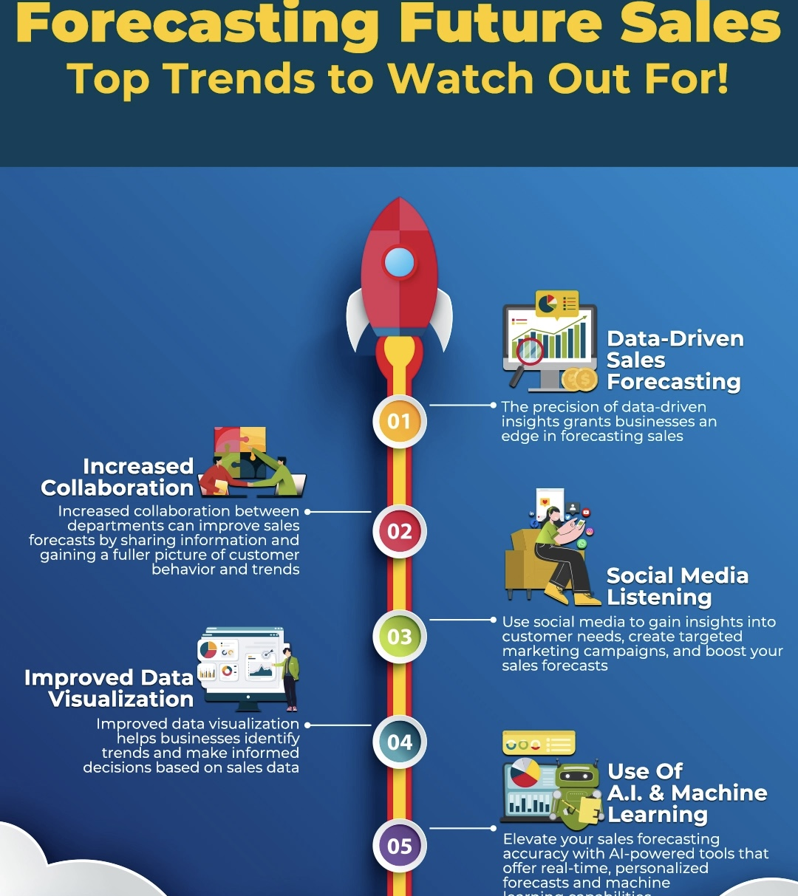
Future Trends in Sales Forecasting
-Integration of advanced analytics and AI technologies.
-Big data utilisation for predictive modeling.
-Real-time data analysis for agile decision-making.
-Personalisation and localisation of forecasts.
-Collaboration with suppliers for demand sensing

Slide 10
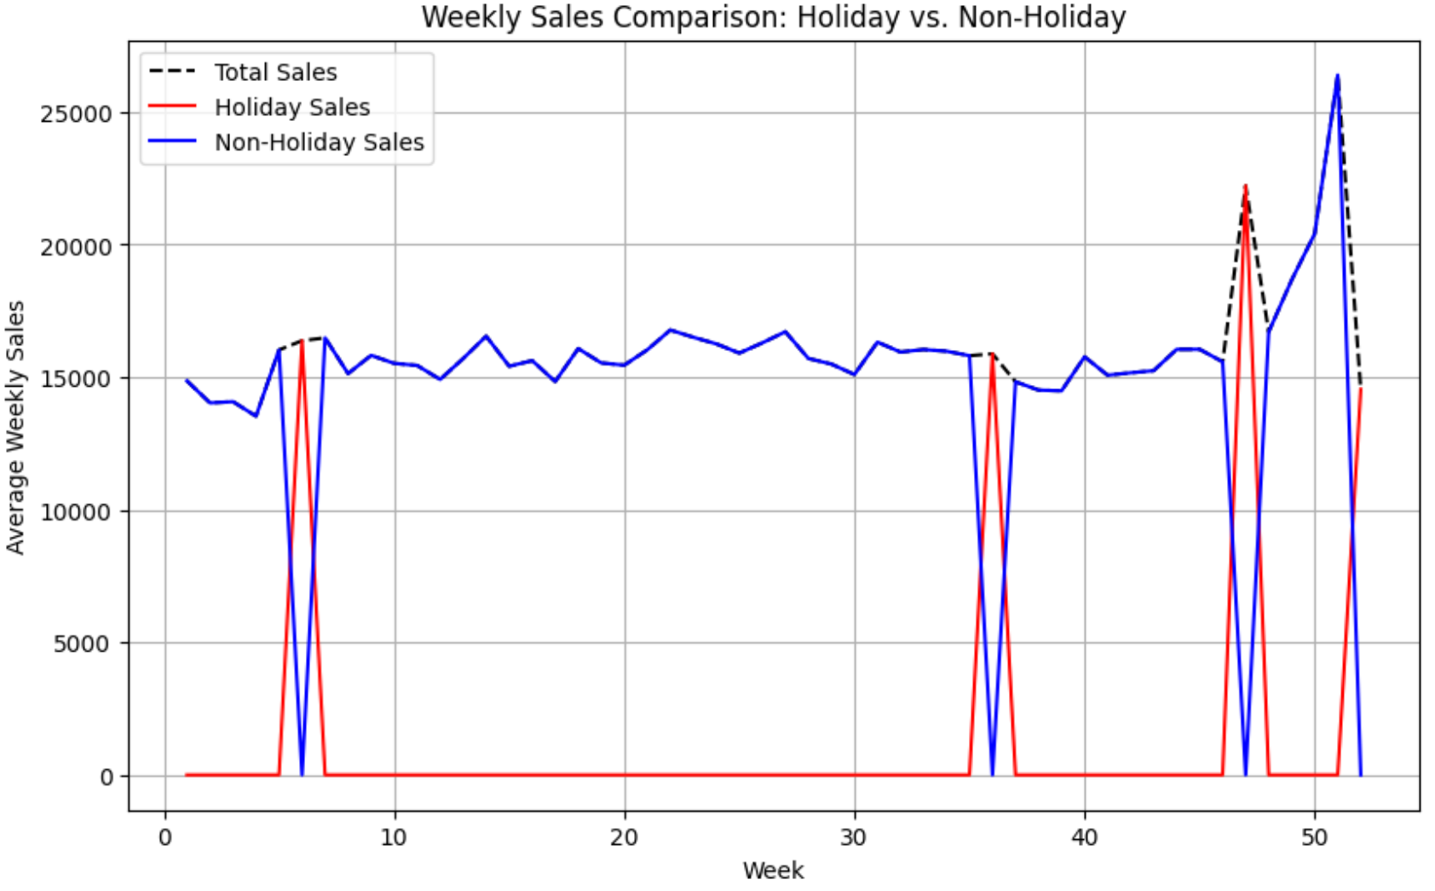
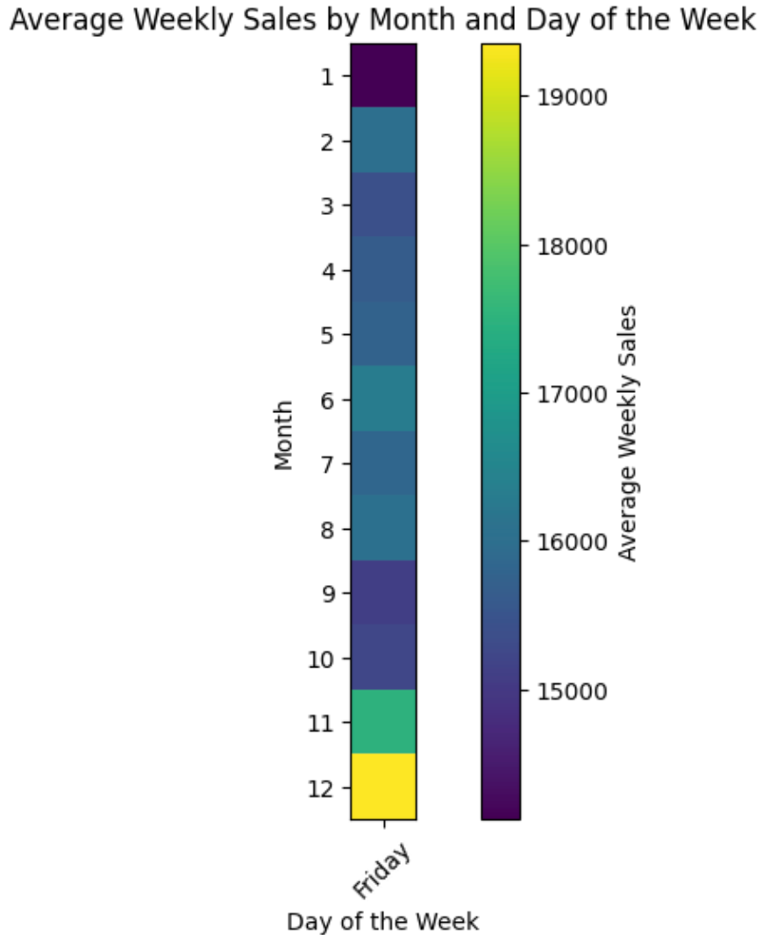
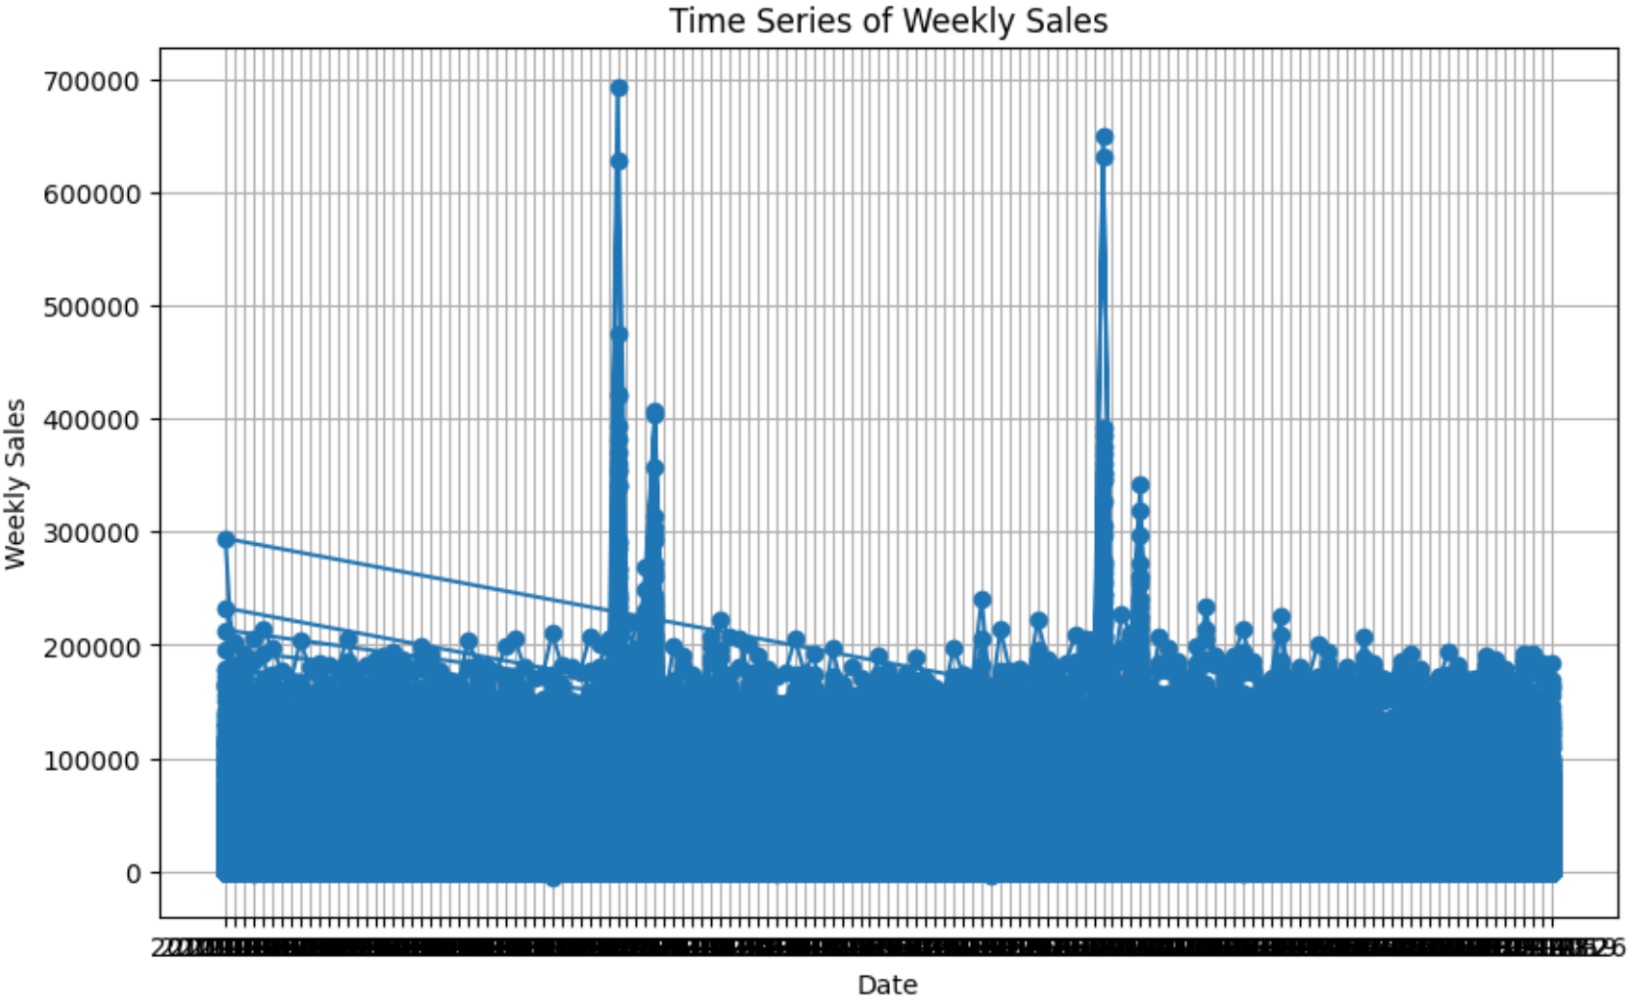
Snapshots
Fig 3- Time Series Plot
Fig 2- Line Plot
Fig 1- Heat Map

Slide 11

Conclusion
In conclusion, the journey of Walmart's sales forecast reveals not just a statistical exercise but a strategic imperative in today's retail landscape. Through meticulous analysis, advanced technologies, and an unwavering commitment to innovation, Walmart continues to pave the way forward in predicting sales with unparalleled accuracy and foresight.
As we reflect on the insights gleaned from this exploration, it becomes evident that the significance of sales forecasting extends far beyond mere numbers. It serves as a cornerstone for Walmart's operational efficiency, supply chain optimisation,
and ultimately, customer satisfaction.

